Slide 1
Lesson 5: wall following
Seshan brothers

Slide 2
What is wall following?
Wall Following is when your robot moves along the wall
This helps ensure that your robot moves straight
On many FIRST LEGO League fields you might find that the layout is open enough to ride the wall/follow the wall.
The particular example on this page is from Hydro Dynamics and the challenge mat extended the full length and width of the table, thus allowing wall following on East wall. In addition, there were very few mission models on the South wall which allowed for wall following.

Slide 3
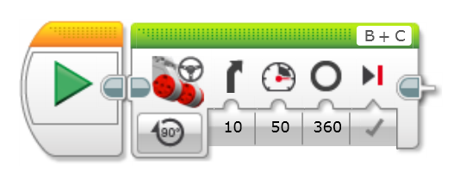
Staying on a WALL
Wall Following can be accomplished with both programming and building techniques.
In programming, you can set the steering block slightly positive or negative so that the robot will curve into the wall while moving forward.
In addition, wheels can be used to smoothly ride along the wall.
This is may be especially critical if the table walls have rough paint or imperfections (wood knots, screw holes, etc.)
Sample Code in EV3-Lab

Slide 4
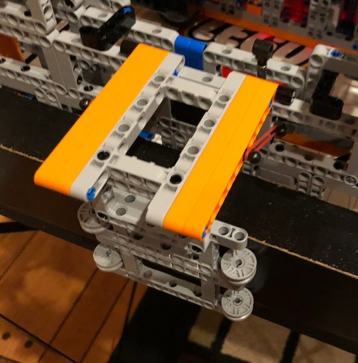
Staying on the wall, continued
Teams have the option of building an arm or clamp that holds on to the wall as it rides it
Pros:
The robot will reliably stay along the wall
Cons:
The rules usually require that the robot stay in base at launch (inside the walls)
The arm must extend only after launch, thus requiring a passive or motorized mechanism to drop later
The rules in some years have required that the robot not be past base even on the return
Therefore the robot may need to bring the arm back up
Some venues have poles that would prevent your robot from riding the wall
Note:
Make sure that it will work for both 2.5 and 3.5 in wall heights
Arm that drops and clamps on to wall

Slide 5
MOVING AWAY FROM THE WALL
Depending on the direction of the robot when turning off a wall, different techniques must be used
In the situation in Figure 1, when the robot tries to move off the wall, the rear of the robot will hit the wall.
Programming Solution: Make the robot curve off the wall smoothly instead of doing a sharp turn
Building Solution: Add small wheels to make the connection between the wall and the robot more smooth
In the situation in Figure 2, a sharp turn will work because the rear of the robot is turning off the wall.
Figure 1
Figure 2

Slide 6
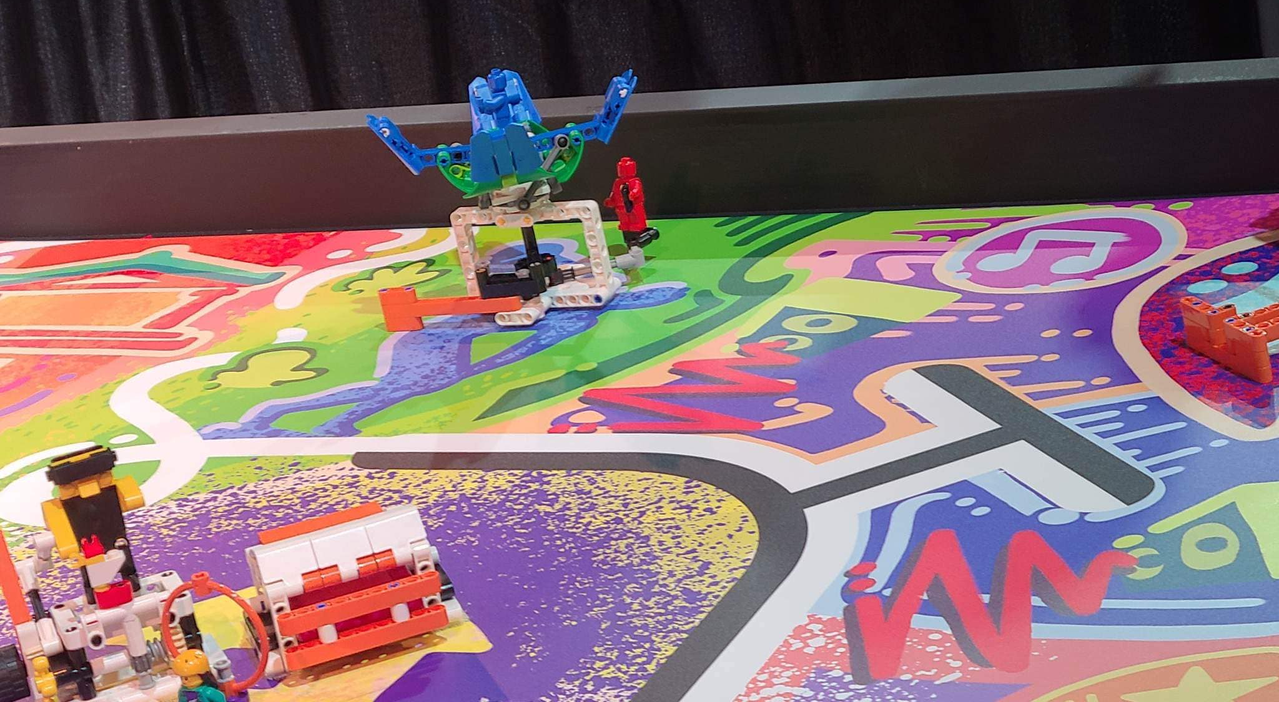
WHAT’S Next: Apply these techniques

Slide 7
Credits
This tutorial was created by Sanjay Seshan and Arvind Seshan
More lessons at www.ev3lessons.com, www.primelessons.org, and www.flltutorials.com
This work is licensed under a Creative Commons Attribution-NonCommercial-ShareAlike 4.0 International License.

