Slide 1
Cable management
Seshan brothers

Slide 2
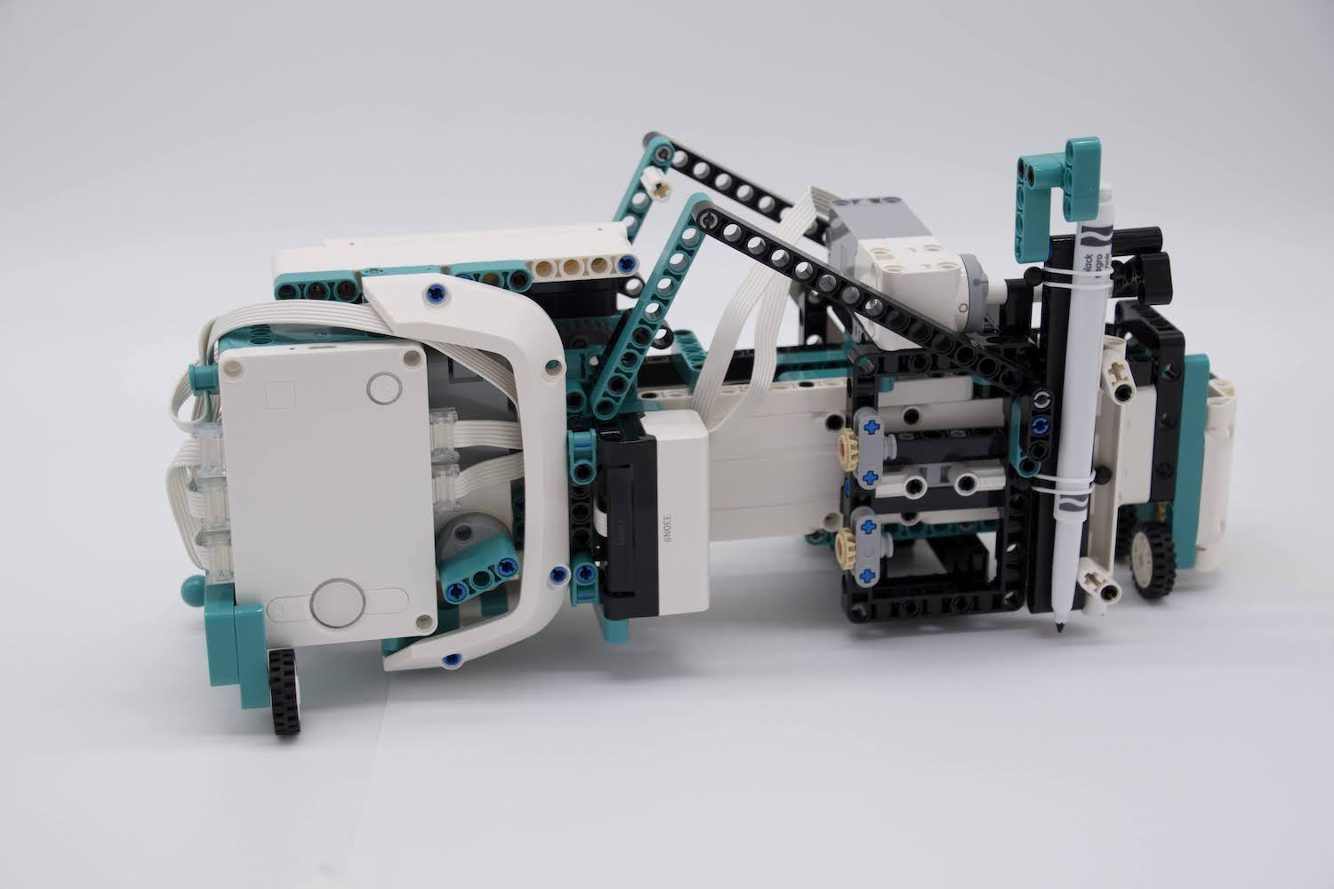
What is cable Management?
No matter what robot you are building (for fun, for a class, or competition), you have to be able wire your robot well
There are three reasons:
Aesthetics – The robot needs to look nice
Convenience – The wires should not be in the way of operating the robot
Identification – If you need to replace a part on the robot or rewire, you should be able to trace which wire goes where
Printer created by Seshan Brothers

Slide 3
EV3 Cables
The EV3 Edu Core set (#45544) and the Retail set (#31313) come with the following cable lengths
4 x 25 cm/10 in. cables, 2 x 35 cm/14 in. cables, and 1 x 50 cm/20 in. cables.
If you break the tip on the cables or you need extra wires, you will need to purchase replacements

Slide 4
SPIKE PRIME CABLES
SPIKE Prime cables are permanently attached to motors and sensors and come only in fixed lengths
If you damage the cable or the plug at the end, you cannot replace the wire so take care of them!
SPIKE Prime cables are much thinner and more flexible compared to EV3 cables. This allows you to tuck them into your robot more easily
While some 3rd party plugs/adapters/replacement parts may exist, you may not use these in FIRST LEGO League

Slide 5
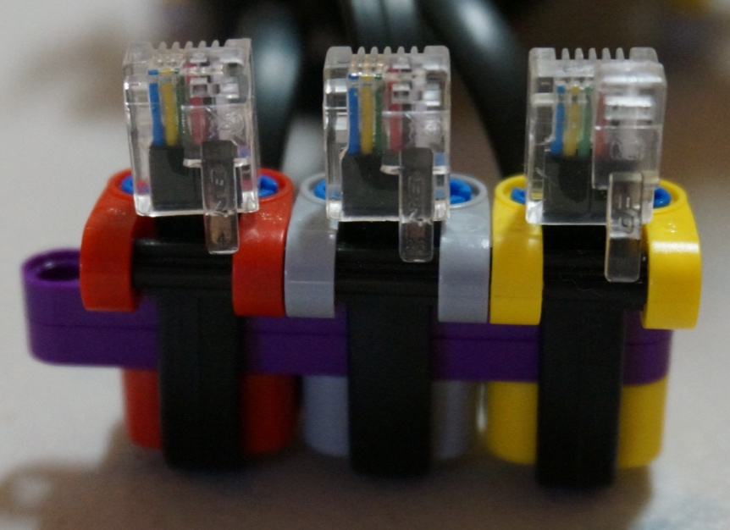
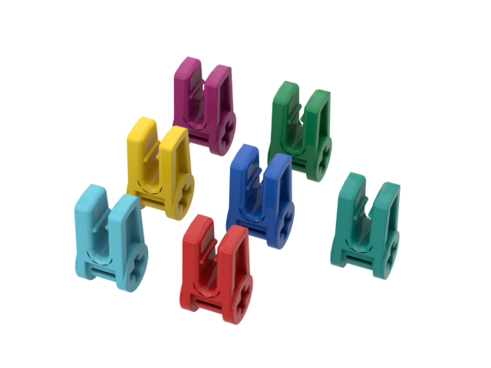
CABLE IDENTIFICATION
You can use LEGO rubber bands to indicate with wire is for which sensor or motor. However, LEGO rubber bands are expensive and fragile, and not that easy to replace.
Instead, consider wrapping your wire with colored LEGO pieces if using an EV3, or using the colored clips that come with SPIKE Prime

Slide 6
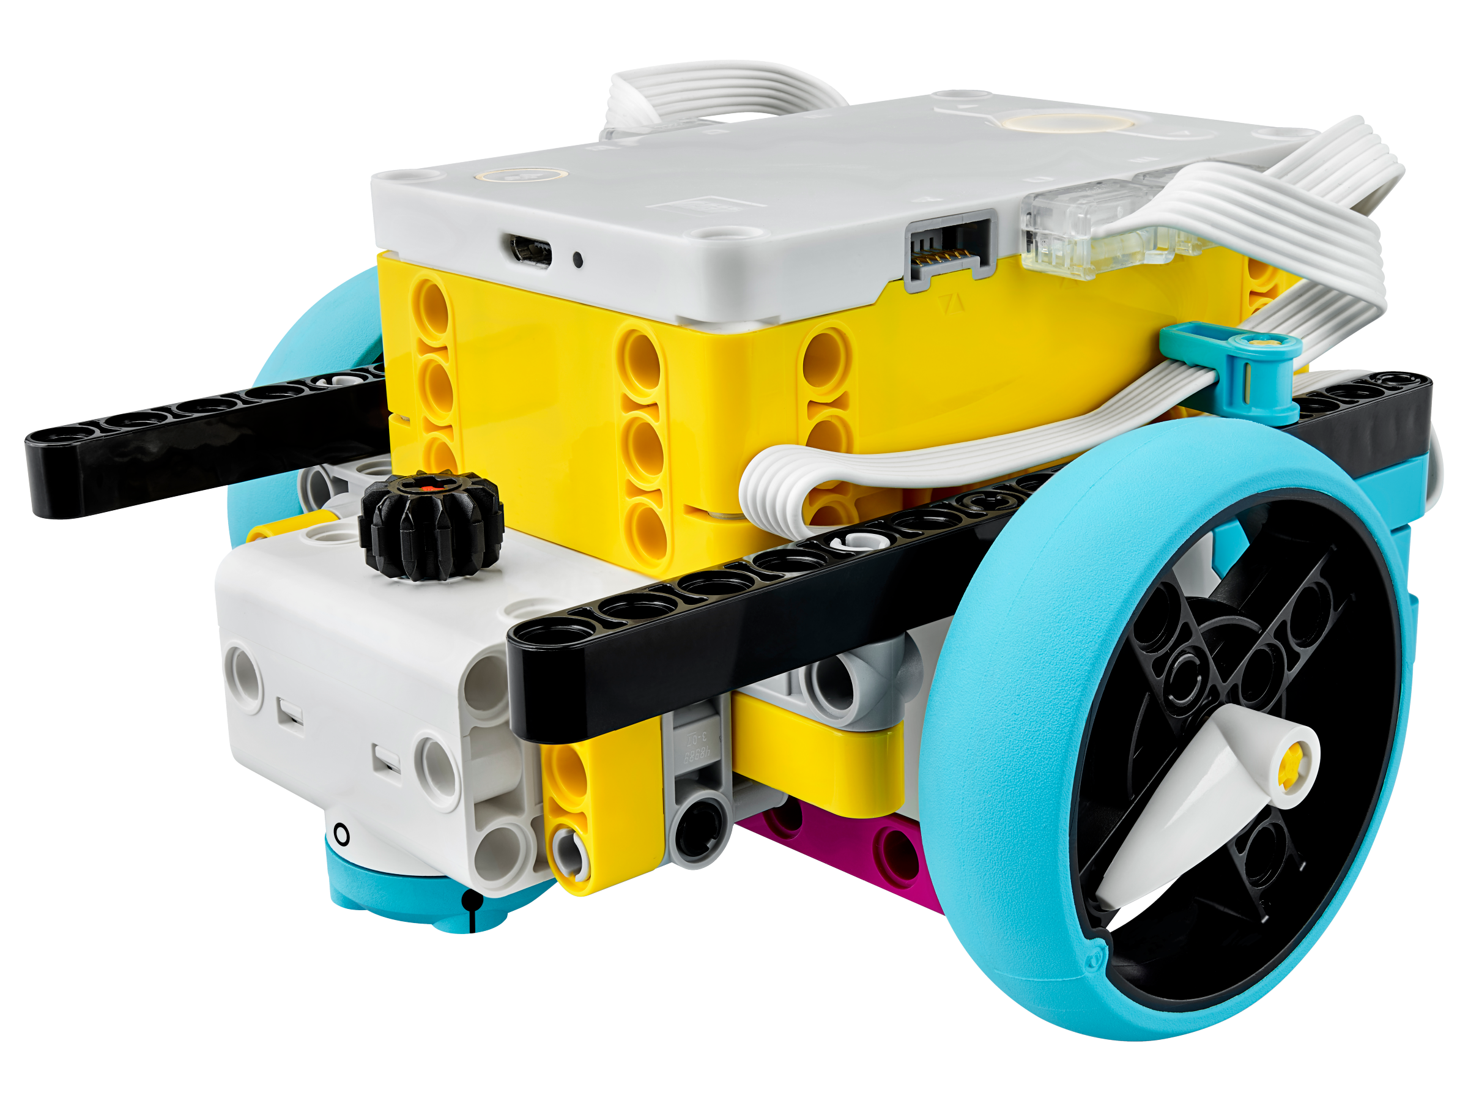
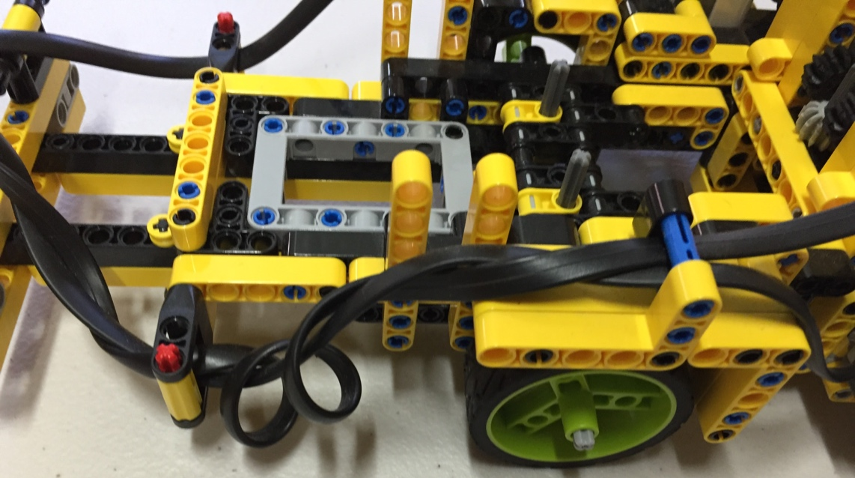
Shorten Cables
If you are using an EV3, use the most appropriate length cable for the connection first
If the cables are too long on your EV3 or SPIKE Prime, you can wrap them around each other or beams, or fold & tuck them into available places, etc.

Slide 7
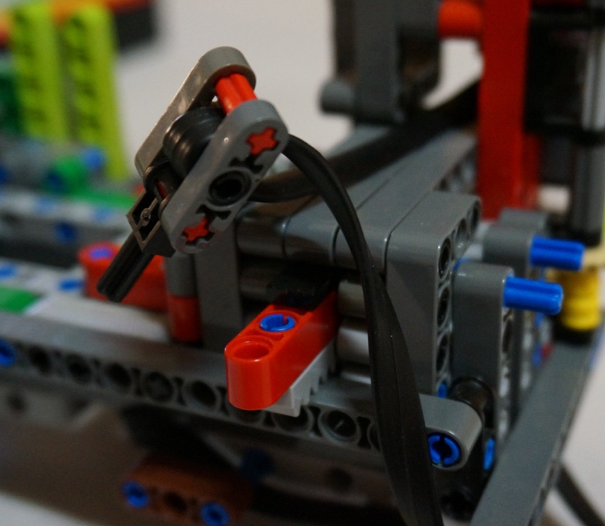
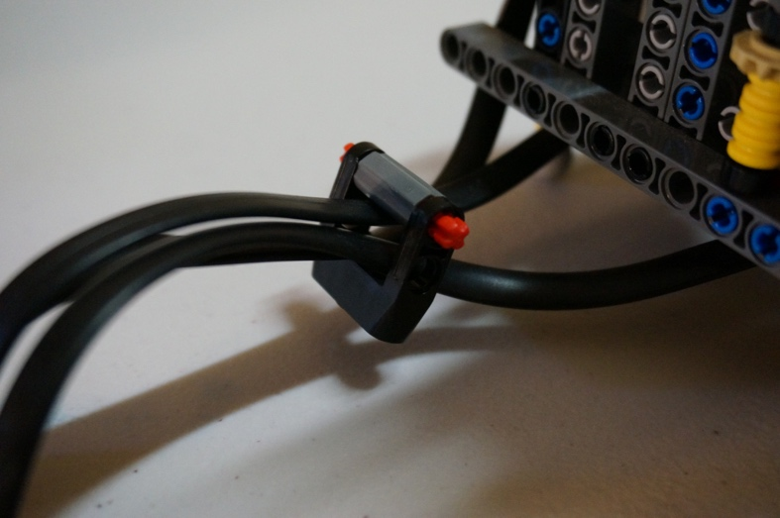
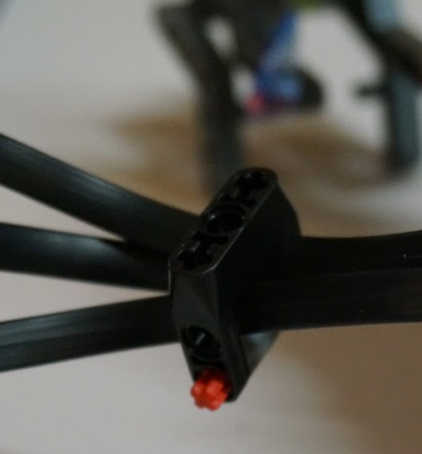
CABLE HOLDERS FOR BUNDLING
Cable holders can identify what they are (use different colors for each sensor/motor)
They can be used to keep multiple wires together (EV3 or SPIKE Prime)
They can be used to attach the wire to a beam (see next page for examples)
LEGO gear boxes can find a new use as cable holders. In the images, cables are fed through a gear box piece. They are spacious enough to hold multiple cables.

Slide 8
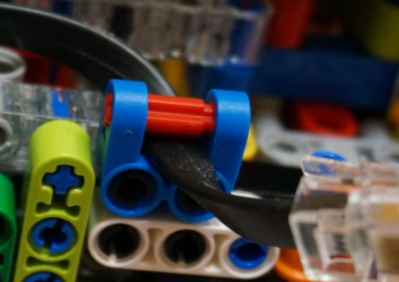
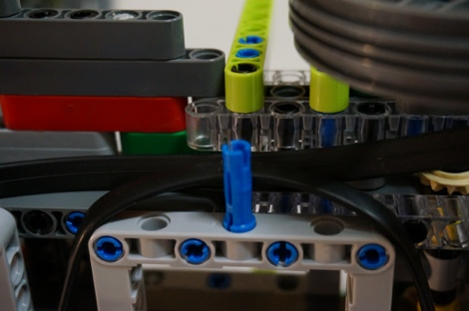
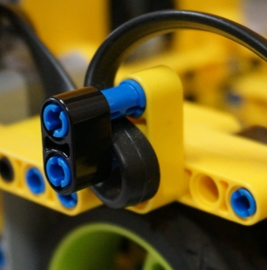
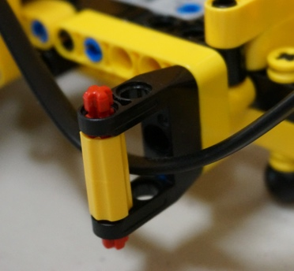
CABLE GUIDE RAILS
Building guide rails helps to keep them out of the way of movable parts of the robot and makes them always stay in the same spot on your robot.

Slide 9
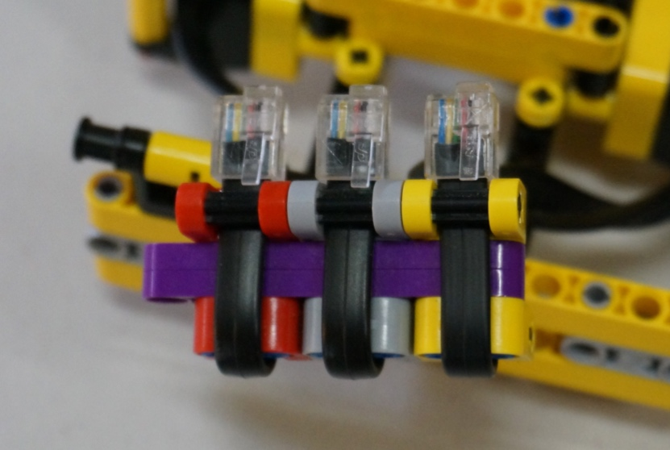
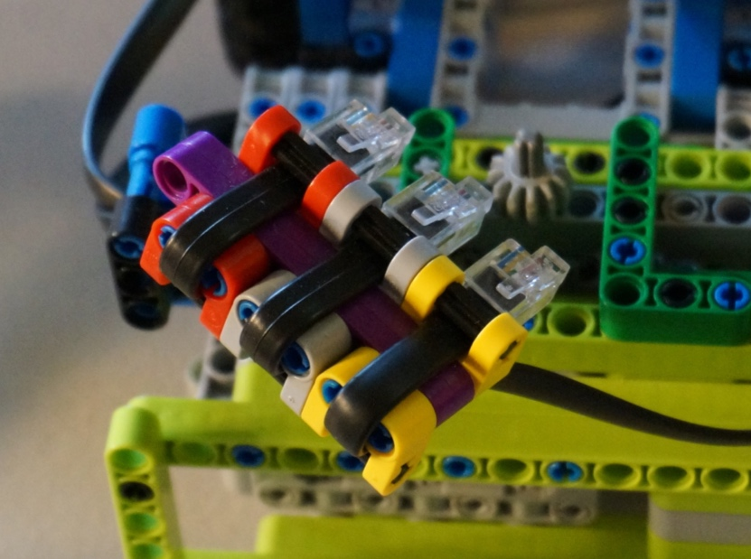
PLUG-IN Guides
If you design a robot where you have to frequently change your motors/sensors out, you need a way to plug the cables in efficiently
The technique in the image on the right keeps the spacing between the wires correct at all times and lets you install them all at the same time.
Using different colors lets you color code which wire goes to which sensor or motor.

Slide 10
Credits
This tutorial was created by Sanjay Seshan and Arvind Seshan
Photos and ideas from FIRST Tech Challenge 8393 Giant Diencephalic BrainSTEM Robotics (Former FIRST LEGO League Team)
More lessons at www.ev3lessons.com
This work is licensed under a Creative Commons Attribution-NonCommercial-ShareAlike 4.0 International License.

