Slide 1
INNOVATION Project Overview
Seshan Brothers

Slide 2
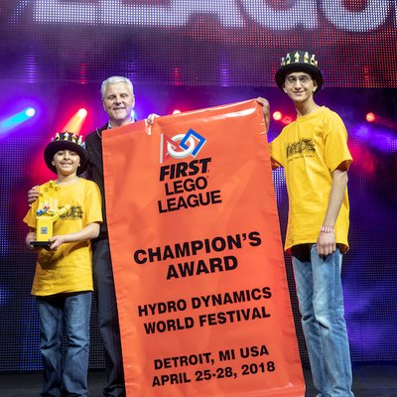
About The AUTHOR
Seshan Brothers were on team Not the Droids You Are Looking For
Our research project for Trash Trek was a Global Innovation Award semi-finalist project (Top 20 out of 30,0000 teams).
Our research project in Nature’s Fury won Innovative Solution at the FIRST LEGO League International Open in Toronto.
Our research project for World Class was EV3Lessons.com which resulted in the site you are currently on! ;-)
We are the Champion’s award winners from World Festival 2018

Slide 3
What is the INNOVATION Project?
A group research project related to the year’s theme
Research a real-world problem
Come up with an innovative solution
Iterate the idea and share your solution
Themes:
2011: Food Factor (food safety)
2012: Senior Solutions (senior citizens)
2013: Nature’s Fury (natural disasters)
2014: World Class (education)
2015: Trash Trek (garbage)
2016: Animal Allies (animals)
2017: Hydro Dynamics (water)
2018: INTO ORBIT (space)
2019: City Shapers (cities)
2020: RePLAY(exercise)
2021: Cargo Connect (transportation)
2022: SUPERPOWERED (energy)
2023: MASTERPIECE (arts)

Slide 4
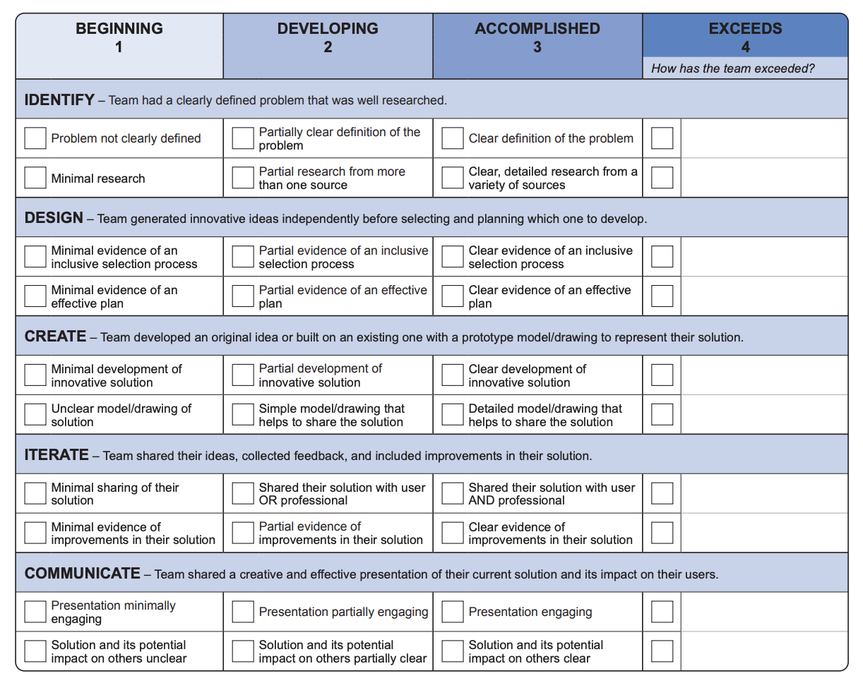
ThE RUBRICS WILL GUIDE THE PROCESS
Identify
Identify a problem, do background research, analyze existing solutions
Design
Think of different solutions, select one and come with a plan
Create
Develop a solution including a prototype/model/drawing
Iterate
Share the solution with others and improve the idea
Communicate
Create an effective presentation for judges

Slide 5
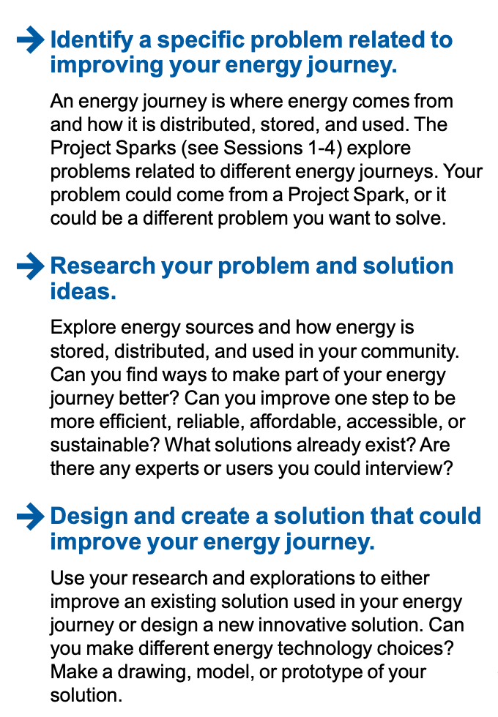
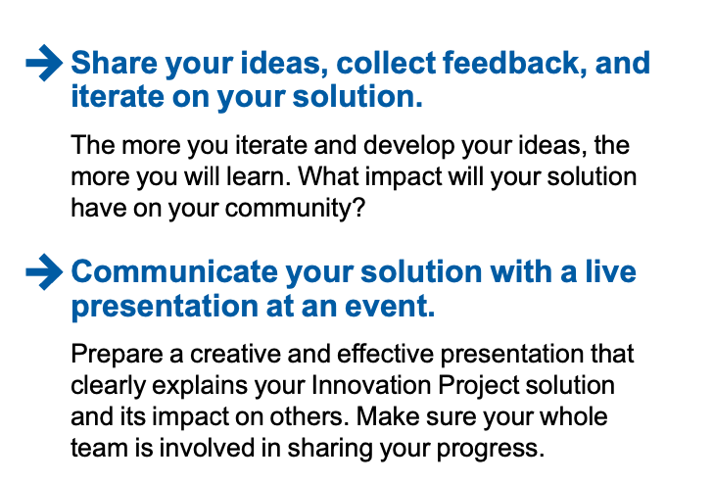
START WITH THE CHALLENGE PROMPT
SAMPLE FROM SUPERPOWERED

Slide 6
PICK A PROBLEM That is meaningful
Always think of a problem first
The problem can be as small or big as you want
Most students relate better to local problems that impact their lives

Slide 7
SAMPLE PROBLEMS FROM PAST YEARS
2011: Food Factor (food safety)
Detecting spoilt milk
2012: Senior Solutions (senior citizens)
Helping seniors remember where they left their possessions
2013: Nature’s Fury (natural disasters)
An early-warning ash detection system for airplanes
2014: World Class (education)
A better way to learn to program the EV3 (EV3Lessons.com)
2015: Trash Trek (garbage)
A more efficient way to recycle batteries
2016: Animal Allies (animals)
Bats getting killed by wind turbines
2017: Hydro Dynamics (water)
Detecting leaking pipes

Slide 8
Credits
This lesson was written by Sanjay and Arvind Seshan
More lessons available at www.ev3lessons.com and www.flltutorials.com

