Slide 1
outreach
Michael junge, COACh, Jamestown robowolves

Slide 2
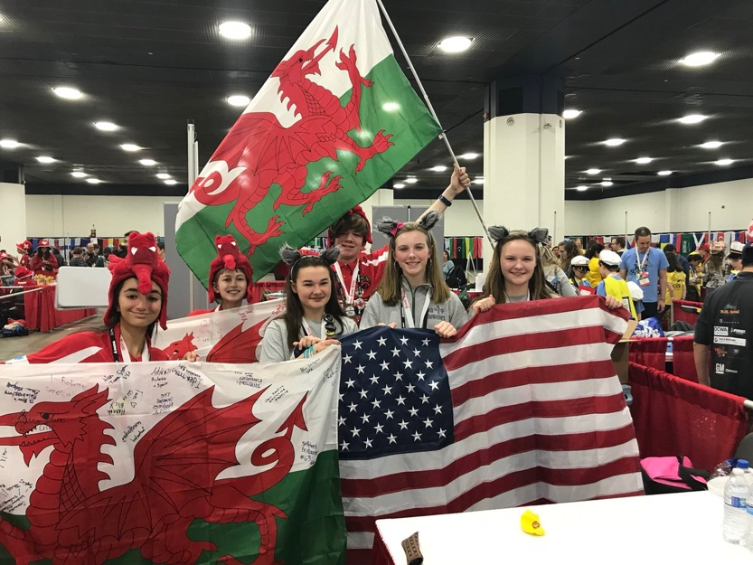
MEET THE AUTHORS
The Jamestown Robowolves have won 2 state championships
They won the First Place Overall Project award at the Razorback Invitational
They won the First Place Inspiration award at World Festival!

Slide 3
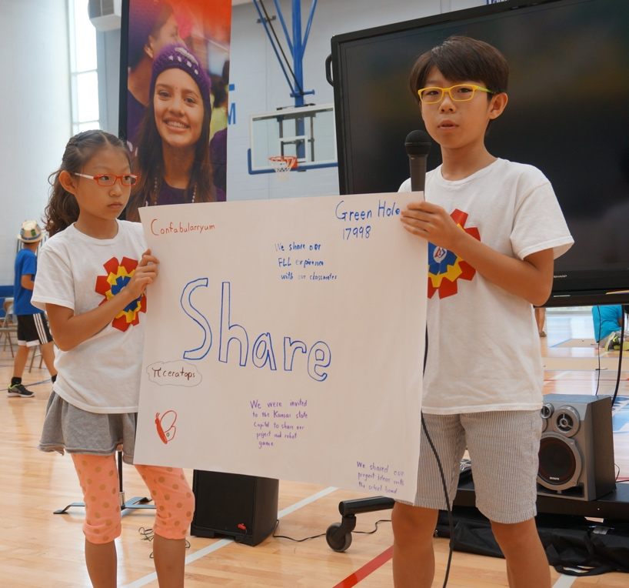
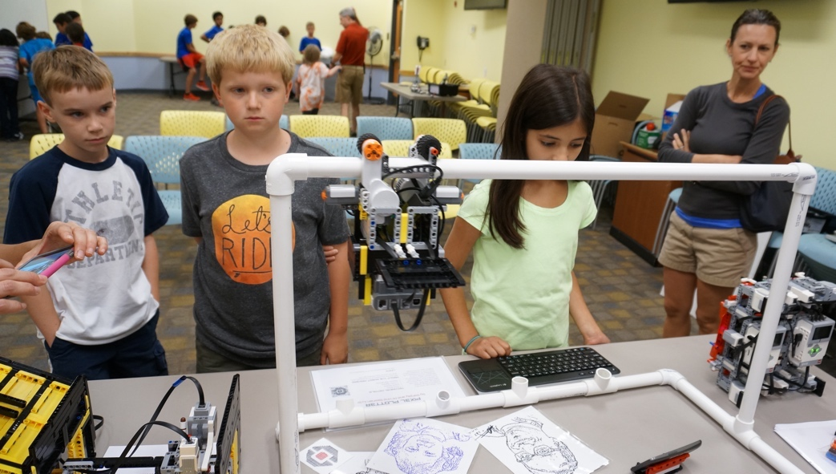
What is outreach in FIRST LEGO League?
In FIRST LEGO League outreach is about sharing your work on the project, the robot, and as a team.
It is also about spreading STEM and FIRST in the community

Slide 4
WHERE can you hold events?
Library
Town Recreation Center
Town government
Local newspaper story or column
Your school, Other schools
4H Clubs
Service organizations (Kiwanis, Lions Club, Rotary, etc.)
Senior Citizens Centers
Churches and church groups
Scout groups
Professional Organizations
Museums
Boys & Girls Clubs
Maker Faires

Slide 5
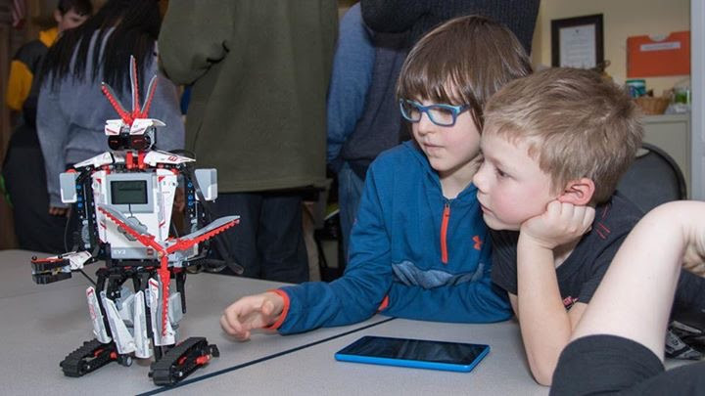
What can you do at an Outreach event
Explain what FIRST LEGO League is: team building, STEM focus, more than just robots
Teach about your project, core values challenges, robot building
Demo your team’s robot
Display your project or core values posters
Run a programming class (if you have enough equipment)
Display MINDSTORMS models that the audience can interact with
Anything! Just talk about what a great time you have with FIRST, what skills you have been learning, and why you think it’s important!

Slide 6
How do you set them up?
Talk to team parents; someone is usually a member of some group or knows someone who is
Contact the Children’s Librarian
Write to the editor of the local paper or magazine
Ask the school Principal to talk to PTA or Honor Society
Phone call, email, carrier pigeon – whatever works
Write your details down before you contact someone – make sure you pass them all along!
Things to think about before you call:
What do you plan to do at the event?
How many participants can attend (you might be limited by the number of robots/laptops you have or the size of the room)?
What ages will you allow?
Do you want people to sign up in advance?
How long will the event be for?
What equipment do you need from the host?
Is there a cost?
Do parents have to stay?
Why is this event something that the host might value?
Does the venue allow you to take photographs?

Slide 7
SAMPLE LETTER for setting up an event
Dear Librarian,
I am a resident of your town and a member of a local youth robotics team. You can read more about our team here: www.teamwebsite.com.
My team and I were wondering if the library would be interested in hosting a Robotics Demo for your patrons. We know that you have been adding STEAM classes to your summer programs.
Our team has been participating in a program called FIRST LEGO League for three years. By doing such demos, we hope to encourage more children to participate in STEM programs. We know that your library is very supportive of children’s/community activities and would love to come and run a class. There would be no cost to the library or kids. We just need a room with enough space for a 4ft X 8ft table (that we will bring) and space for an audience to come and go (maybe about 10-15 people at a time). We expect between 50-100 people total to attend. No sign-up is required for this event and it is open to any age. We will demonstrate our FIRST LEGO League robot (a robot built out of LEGO MINDSTORMS) to the attendees and answer any questions they may have. The session will be 2 hours long.
In addition, we would like permission to take photographs of attendees at the event. These will be used on our team’s website/social media pages and shared with judges at future competitions.
You can let us know what your thoughts are and we will be happy to work with you. We are flexible and available almost any evening or weekend in July. You can contact me at student@fllteam.com.
Sincerely,
FLL Student
This letter introduces the team, gives them a link for more information, tells the goals of the event, and lets them know key information such as cost and space requirements from the host.
If you plan to do a programming or hands-on workshop, you would need to specify that you are looking for classroom-type setup (tables and chairs) and how many people and what age are welcome to sign up.
Remember to always go early to set up yourself and stay late to clean up and leave the room as you found it.
Send a thank you letter to your host at the end of the event.

Slide 8
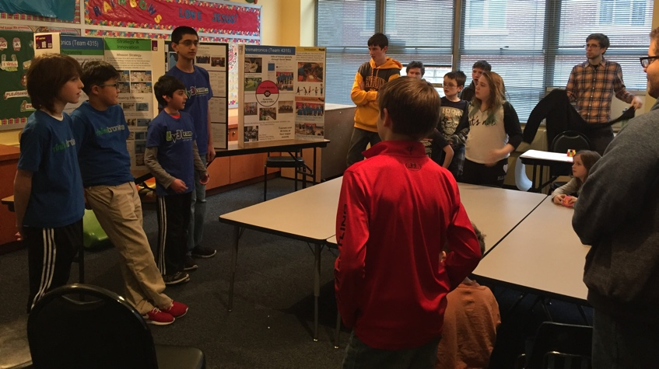
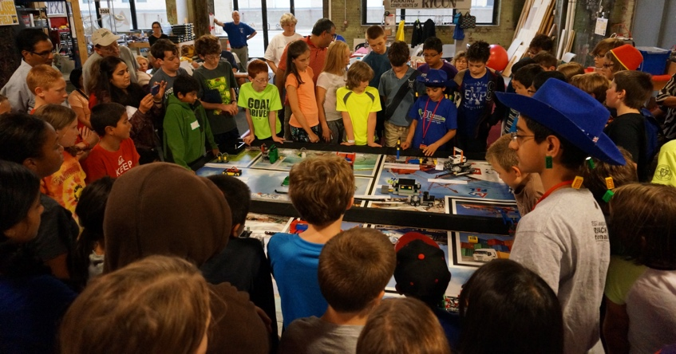
What types of equipment might you need?
FIRST LEGO League Demo –
Your robot, a FIRST LEGO League table, your challenge set
A plan – show the board or just simple robot tricks?
Programming Class –
Chromebook, laptops or tablets
Robots
Projector
Lesson plan
Core Values and Project presentation
A prepared activity
Your poster boards
MINDSTORMS models
Models built in advance

Slide 9
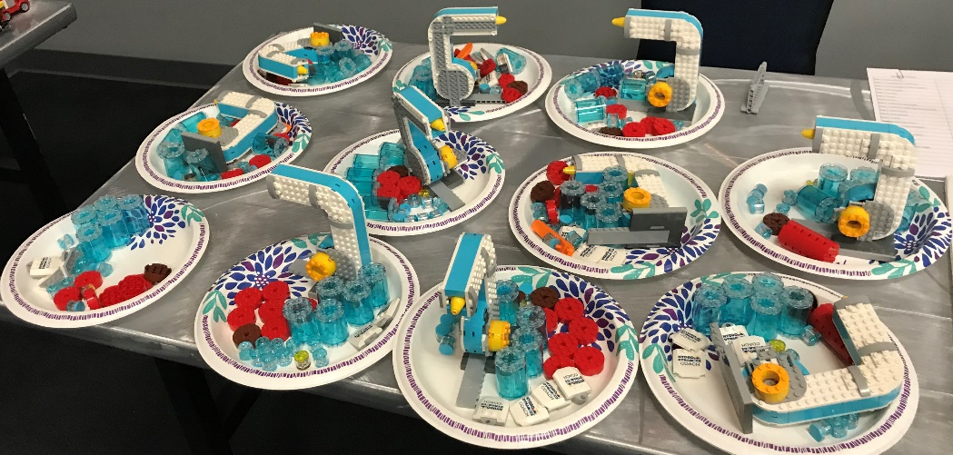
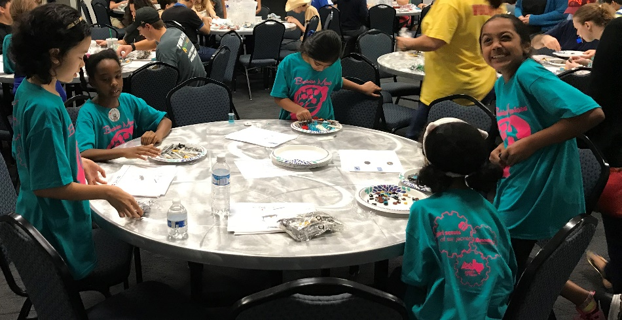
OTHER OUTREACH Opportunities
Volunteer to help your Operational Partner build models for local FLL tournaments
Sent in by Maniacs Brainiacs

Slide 10
CREDITS
This lesson was written by Michael Junge, http://www.jamestownrobowolves.org/home
More lessons for FIRST LEGO League are available at www.flltutorials.com
Creative Commons Attribution-NonCommercial-ShareAlike 4.0 International License

